Slide 1

Dr. Sajid Iqbal
Department of Computer Science
Bahauddin Zakariya University, Multan

Slide 2
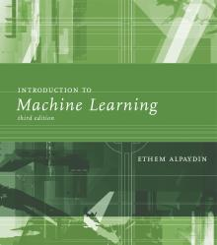
INTRODUCTION TO Machine Learning 3rd Edition
ETHEM ALPAYDIN
© The MIT Press, 2014
alpaydin@boun.edu.tr
http://www.cmpe.boun.edu.tr/~ethem/i2ml3e

Slide 3
4.8 Model Selection Procedures

Slide 4
Model Selection Procedures
There are a number of procedures we can use to fine-tune model complexity
Cross Validation
We cannot calculate the bias and variance for a model, but we can calculate the total error
A training set
Increase in model complexity, decreases the training error
Error on validation set decreases to an extent then stop decreasing or start increasing if there is noise in data
In real life, we cannot calculate the bias and estimate it using validation error
However validation error also contains the variance of noise

Slide 5
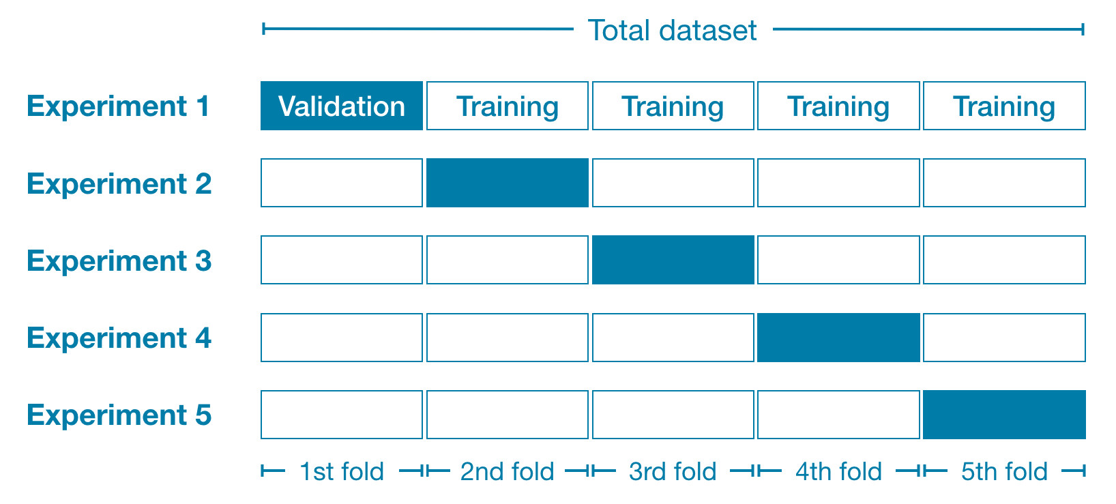





Cross Validation
$$g_{1}(x)$$
$$g_{2}(x)$$
$$g_{3}(x)$$
$$g_{4}(x)$$
$$g_{5}(x)$$

Slide 6

Model Selection Procedures
$$\begin{aligned}E^{′}=error on data+λ∗model complexity\#\end{aligned}$$
Regularization
An augmented error function is used
Penalize the complex models with large variance using weight $λ$
Large value of $λ$ favors simple models and bias may be introduced
$λ$ is optimized using cross validation
First term in equation is training error
Second is an optimism term estimating the discrepancy between training and test error
Methods such as Akaike’s information criterion (AIC) and Bayesian information criterion (BIC) work by estimating this optimism and adding it to the training error to estimate test error, without any need for validation

Slide 7
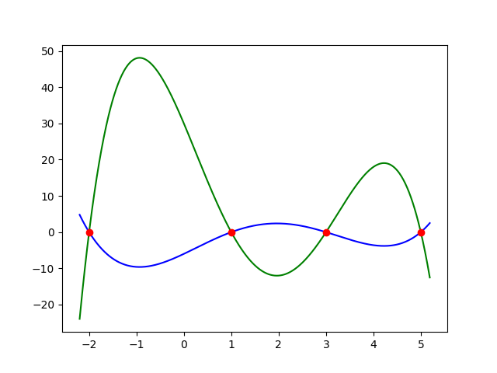



Regularization
$$Green Curve$$
$$h_{1}\left(x\right)=−x^{4}+7x^{3}−5x^{2}−31x+30$$
$$Blue Curve$$
$h_{2}\left(x\right)=\frac{x^{4}}{5}−\frac{7x^{3}}{5}+x^{2}+\frac{31x}{5}−$6

Slide 8
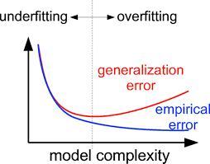

Regularization
$$\begin{aligned}E^{′}=error on data+λ∗model complexity\#\end{aligned}$$
The magnitude of 2nd term
increases linearly with the number of inputs (features) d
decreases with increase in training set size N
increases with the variance. As noise is added $σ^{2}$
Variance of noise can be estimated from the error of a low-bias model
Model Complexity Measure
Number of independent variables in model
VC dimension is another measure of model complexity
Structural risk minimization (SRM)
uses a set of models ordered in terms of their complexities.
Set of decreasing $λ_{i}$ to get a set of models ordered in increasing complexity.
Model selection by SRM then corresponds to finding the model simplest in terms of order and best in terms of empirical error on the data.

Slide 9
Model Selection Procedures
Minimum description length (MDL)
It is description length based on an information theoretic measure.
Kolmogorov complexity of a dataset is defined as the shortest description of the data.
If the data is simple, it has a short complexity
For a sequence of ‘0’s, we can just write ‘0’ and the length of the sequence.
If the data is completely random, we cannot have any description of the data shorter than the data itself.
If a model is appropriate for the data, then it has a good fit to the data
Model description can be used instead of data
We want simplest model describing the data
There is trade off between model complexity and interpretability (how well it explains the data)

Slide 10


Model Selection Procedures
Bayesian model selection:
This model is used when we have some prior knowledge about the appropriate class of approximating functions.
This prior knowledge is defined as a prior distribution over models, $p(model)$
Given the data and assuming a model, we can calculate $p(model|data)$using Bayes’ rule
choose the model with the highest posterior probability, or
take an average over all models weighted by their posterior probabilities
$$p\left(model | data\right)=\frac{p\left(data | model\right)p\left(model\right)}{p\left(data\right)}$$

Slide 11
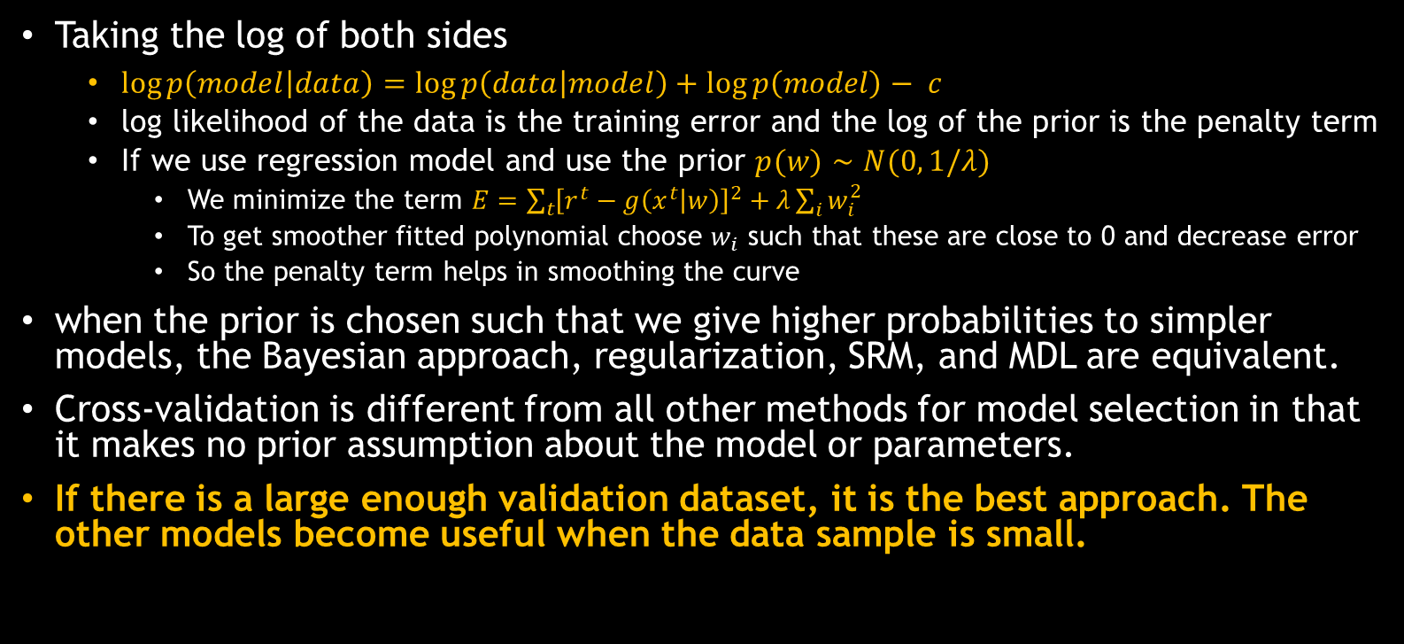
Taking the log of both sides
$\log{p\left(model | data\right)}=\log{p\left(data | model\right)}+\log{p\left(model\right)}− c$
log likelihood of the data is the training error and the log of the prior is the penalty term
If we use regression model and use the prior $p(w)∼N(0, 1/λ)$
We minimize the term $E=\sum_{t}{{\left[r^{t}−g\left(x^{t} | w\right)\right]}^{2}+λ\sum_{i}{w_{i}^{2}}}$
To get smoother fitted polynomial choose $w_{i}$ such that these are close to 0 and decrease error
So the penalty term helps in smoothing the curve
when the prior is chosen such that we give higher probabilities to simpler models, the Bayesian approach, regularization, SRM, and MDL are equivalent.
Cross-validation is different from all other methods for model selection in that it makes no prior assumption about the model or parameters.
If there is a large enough validation dataset, it is the best approach. The other models become useful when the data sample is small.

Slide 12



Thanks for watching
Dr. Sajid Iqbal
Assistant Professor
Department of Computer Science
Bahauddin Zakariya University, Multan
sajidiqbal.pk@gmail.com
https://github.com/sajjo79/Design_and_Analysis_of_Algorithms
Allah Hafiz
COMEDXD

Slide 13
Assignments

